Slide 1
Routing Algorithms
1

Slide 2
Outline
Routing Algorithm
Shortest Path Routing
Flow Based Routing
Distance Vector Routing
Link State Routing

Slide 3
Properties Of Routing Algorithm
Routing is the process of forwarding of a packet in a network so that it reaches its intended destination.
Correctness: The routing should be done properly and correctly so that the packets may reach their proper destination.
Simplicity: The routing should be done in a simple manner so that the overhead is as low as possible. With increasing complexity of the routing algorithms the overhead also increases.
Robustness: Once a major network becomes operative, it may be expected to run continuously for years without any failures. The algorithms designed for routing should be robust enough to handle hardware and software failures and should be able to cope with changes in the topology and traffic without requiring all jobs in all hosts to be aborted and the network rebooted every time some router goes down.

Slide 4
Stability: The routing algorithms should be stable under all possible circumstances.
Fairness: Every node connected to the network should get a fair chance of transmitting their packets. this is generally done on a first come first serve basis.
Optimality: The routing algorithms should be optimal in terms of throughput and minimizing mean packet delays. here there is a trade-off and one has to choose depending on his suitability.

Slide 5
Types Of Routing Algorithms
•
Nonadaptive (Static)
•
•
Do not use measurements of current conditions Static routes are downloaded at boot time
•
Adaptive Algorithms
Change routes dynamically
Gather information at runtime
•
•
•
locally
from adjacent routers from all other routers
•
Change routes
•
•
•
Every delta T seconds
When load changes When topology changes
5

Slide 6
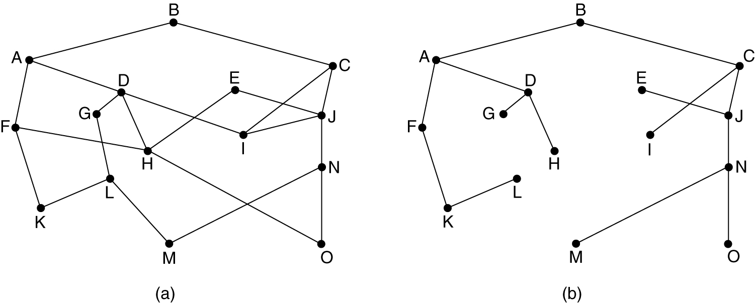
The set of optimal routes to a particular node forms a sink tree.
Sink trees are not necessarily unique.
Goal of all routing algorithms
Discover sink trees for all destinations
(A) A SUBNET. (B) A SINK TREE FOR ROUTER B.
7

Slide 7
Dijkstra’s Algorithm
Each node is labeled (in parentheses) with its distance from the source node along the best known path.
B
7
C
2
3
2
3
E
2
F
A
D
1
2
6
2
4
G
H

Slide 8
(Cont’d)
We want to find the shortest path from A to D.
Initially, no paths are known, so all nodes are labeled with infinity.
B(
C(
E(
F(
A
D(
G(
H(

Slide 9
(Cont’d)
We start out by marking node A (the working node) as permanent.
We examine each of the nodes adjacent a, relabeling each one with the distance to a.
B(2, A)
C(
2
E(
F(
A
D(
6
G(6, A)
H(

Slide 10
(Cont’d)
We make B with the smallest label permanent.
B becomes the new working node.
B(2, A)
C(
E(
F(
A
D(
G(6, A)
H(

Slide 11
(Cont’d)
We examine each of the nodes adjacent B, relabeling each one with the distance to B.
B(2, A)
7
C( 
2
E(4, B
F(
A
D(
G(6, A)
H(

Slide 12
(Cont’d)
We make E with the smallest label permanent.
E becomes the new working node.
B(2, A)
C(9, B)
E(4, B)
F(
A
D(
G(6, A)
H(

Slide 13
(Cont’d)
We examine each of the nodes adjacent E, relabeling each one with the distance to E.
B(2, A)
C(9, B)
E(4, B)
F( 
A
D(
1
2
G(5, E)
H(

Slide 14
(Cont’d)
We make G with the smallest label permanent.
G becomes the new working node.
B(2, A)
C(9, B)
E(4, B)
F(6, E)
A
D(
G(5, E)
H(

Slide 15
(Cont’d)
We examine each of the nodes adjacent G, relabeling each one with the distance to G.
B(2, A)
C(9, B)
E(4, B)
F(6, E)
A
D(
4
G(5, E)
H( G

Slide 16
(Cont’d)
We make F with the smallest label permanent.
F becomes the new working node.
B(2, A)
C(9, B)
E(4, B)
F(6, E)
A
D(
G(5, E)
H(9, G)

Slide 17
(Cont’d)
We examine each of the nodes adjacent F, relabeling each one with the distance to F.
B(2, A)
C(9, B)
3
F(6, E)
2
E(4, B)
A
D(
G(5, E)
H(8, F)

Slide 18
(Cont’d)
We make H with the smallest label permanent.
H becomes the new working node.
B(2, A)
C(9, B)
E(4, B)
F(6, E)
A
D(
G(5, E)
H(8, F)

Slide 19
(Cont’d)
We examine each of the nodes adjacent H, relabeling each one with the distance to H.
B(2, A)
C(9, B)
E(4, B)
F(6, E)
A
D(10, F
2
G(5, E)
H(8, F)

Slide 20
(Cont’d)
We make C with the smallest label permanent. C becomes the new working node.
B(2, A)
C(9, B)
E(4, B)
F(6, E)
A
D(10, F
G(5, E)
H(8, F)

Slide 21
(Cont’d)
We examine each of the nodes adjacent C, relabeling each one with the distance to C.
B(2, A)
C(9, B)
3
E(4, B)
F(6, E)
A
D(10, F
G(5, E)
H(8, F)

Slide 22
(Cont’d)
We make D with the smallest label permanent. D becomes the new working node.
B(2, A)
C(9, B)
E(4, B)
F(6, E)
A
D(10, F
G(5, E)
H(8, F)

Slide 23
(Cont’d)
The shortest path from A to D follows.
B(2, A)
C(9, B)
E(4, B)
F(6, E)
A
D(10, H
G(5, E)
H(8, F)

Slide 24
Flow Based Routing Algorithm
It is a non-adaptive routing algorithm.
It takes into account both the topology and the load in this routing algorithm;
We can estimate the flow between all pairs of routers.
From the known average amount of traffic and the average length of a packet you can compute the mean packet delays using queuing theory.
Flow-based routing then seeks to find a routing table to minimize the average packet delay through the subnet.
Given the line capacity and the flow, we can determine the delay. It needs to use the formula for delay time T.
Where, μ = Mean number of arrivals in packet/sec, 1/μ = The mean packet size in the bits, and c = Line capacity (bits/s).

Slide 25
Routing: Distance Vector
Adaptive algorithm
Exchange of info only with neighbours
Data to be available in each router
Routing table: per destination
Distance
Outgoing line
Distance to all neighbours

Slide 26
Algorithm
At each step within a router:
Get routing tables from neighbours
Compute distance to neighbours
Compute new routing table

Slide 27
Routing:Link State
Each router must
Discover its neighbours and learn their network addresses
Measure the delay or cost to each of its neighbours
Construct a packet with these distances
Send this packet to all other routers
Compute the shortest path to every other router

Slide 28
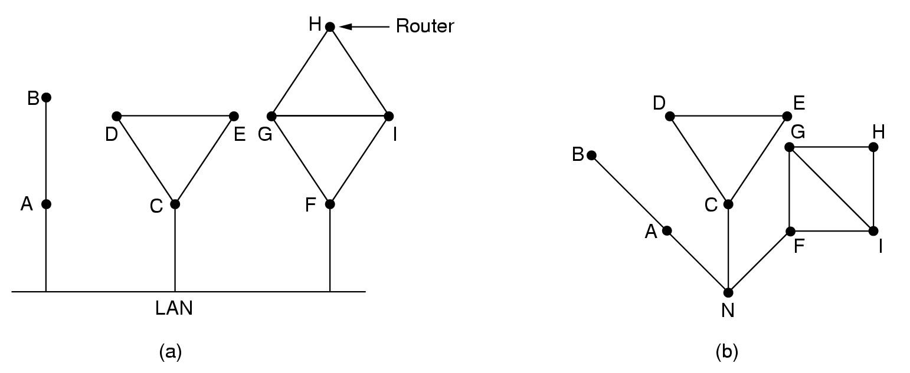
Discovering your neighbors
Send “hello” packet on each point-to-point line. Destination node replies with its address.

Slide 29
Measuring line cost
Send an “ECHO” packet over the line.
Destination is required to respond to “echo” packet immediately.
Measure the time required for this operation.

Slide 30
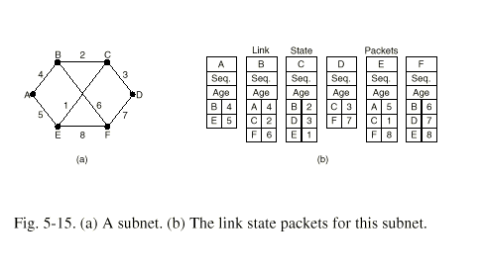
Building link state packets
Packet containing:
Identity of sender
Sequence number + age
For each neighbour: name + distance
43

Slide 31
Distributing the link state packets
Flooding
Each router records the (source, seq. No.)
Only flood and record packets from a source with higher seq.No. Than previously recorded.
Sequence numbers or router records of them can get corrupt.
packets with age zero.
Age in each packet:
Decremented during flooding,
while used in router
Age 0 ➔ info discarded

Slide 32
Computing new routes
With a full set of link state packets, a router can:
Construct the entire subnet graph
Run Dijkstra's algorithm to compute the shortest path to each destination
Problems for large subnets
Memory to store data
Compute time

Slide 33
Thank you

